Slide 1
TEXT ADVENTURE GAME

Slide 2
Tweet it!
In a maximum of 140 characters, you should describe what a computer game is.

Slide 3
What is an adventure text game?
Once upon a time, along time ago (when I was young) computers had very poor graphics. So instead of seeing where you were in the game and moving around you had to make decisions to try and solve the game and use your imagination!

Slide 4
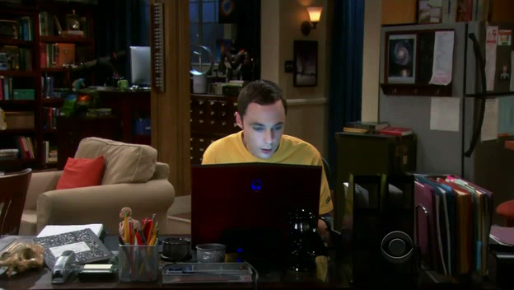
It’s all about imagination

Slide 5
Play a Game
Have a go at a game
click on the links on Frog
And open the game your teacher tells you to
While you are playing the game sketch a map to show what the Game area looks like.

Slide 6
The Design Map
Add information to your map including:
How the rooms / areas are connected
Objects in the rooms / areas
Conversations that take place
Puzzles that need solving

Slide 7
Extension
Can you work out the order the instructions need to be in?
Add numbers to the rooms / areas and annotate to show the order they need to be visited and the order the puzzles need to be solved

